Slide 1
CAP776
PROGRAMMING IN PYTHON

Slide 2
Topics covered:
Data visualization :
introduction to matplotlib,
line plot,
multiple subplots in one figure,
bar chart,
histogram,
box and whisker plot,
scatter plot,
pie charts,
introduction to seaborn,
seaborn Vs matplotlib,
data visualization using seaborn

Slide 3
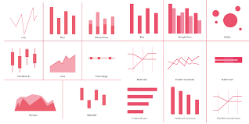
Data visualization
Data visualization is the process of translating large data sets and metrics into charts, graphs and other visuals.
Data Visualization is the presentation of data in graphical format.

Slide 4
Data Visualization in Python using Matplotlib and Seaborn
Matplotlib is a visualization library in Python for 2D plots of arrays.
Seaborn is a dataset-oriented library for making statistical representations in Python.

Slide 5
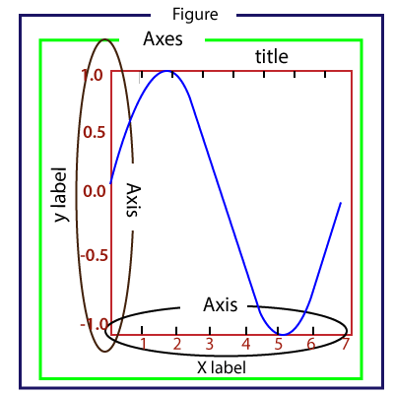
pyplot
Most of the Matplotlib utilities lies under the pyplot submodule, and are usually imported under the plt alias:
import matplotlib.pyplot as plt
Or,
from matplotlib import pyplot as plt

Slide 6
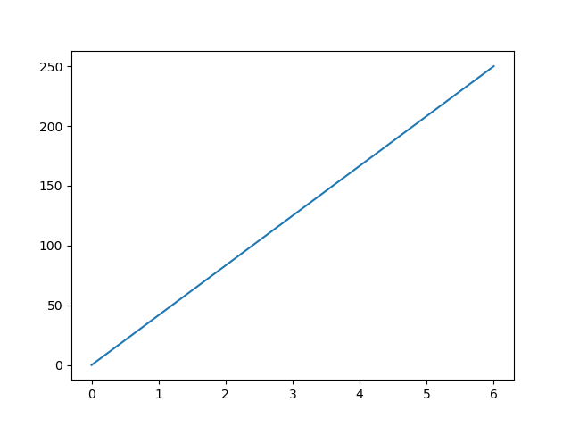
Draw a line in a diagram from position (0,0) to position (6,250):
from matplotlib import pyplot as plt import numpy as np xaxis = np.array([0, 6]) yaxis = np.array([0, 250]) plt.plot(xaxis, yaxis)
plt.show()

Slide 7
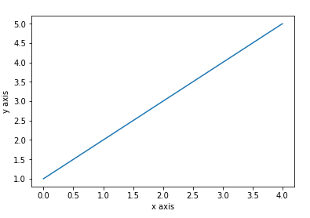
Plot line with single list
from matplotlib import pyplot as plt import numpy as np plt.plot([1,2,3,4,5])
plt.ylabel("y axis")
plt.xlabel('x axis')
plt.show()
If we provide a single list to the plot(), matplotlib assumes it is a sequence of y values, and automatically generates the x values. Since we know that python index starts at 0, the default x vector has the same length as y but starts at 0. Hence the x data are [0, 1, 2, 3, 4].

Slide 8
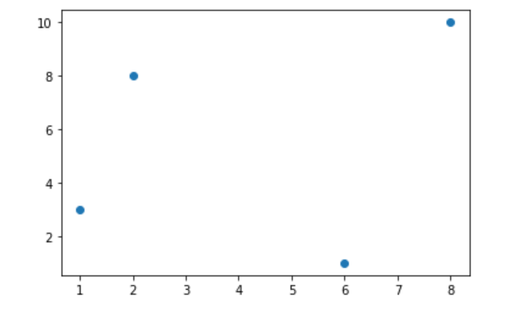
Plotting Without Line
To plot only the markers, you can use shortcut string notation parameter 'o', which means 'rings’.
plot(xpoints, ypoints, 'o')

Slide 9
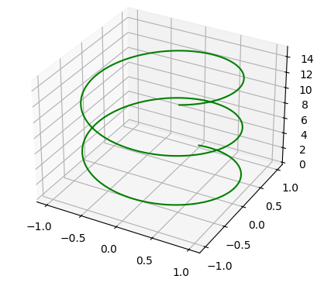
Drawing lines in 3D plane
from mpl_toolkits import mplot3d
import numpy as np
from matplotlib import pyplot as plt
fig = plt.figure()
ax = plt.axes(projection='3d')
# Data for a three-dimensional line
zline = np.linspace(0, 15, 1000)
xline = np.sin(zline)
yline = np.cos(zline)
ax.plot3D(xline, yline, zline, 'green')

Slide 10
Extended 3d lines
from numpy import linspace
import numpy as np
import matplotlib.pyplot as plt
from mpl_toolkits import mplot3d
fig = plt.figure(figsize=(8, 8))
ax = plt.axes(projection='3d')
# Creating Dataset
z = np.linspace(0, 15, 1000)
x = np.sin(z)
y = np.cos(z)
ax.plot3D(x, y, z, 'green')

Slide 11
Program continues…
# 360 Degree view
for angle in range(0, 360):
ax.view_init(angle, 30)
plt.draw()
plt.pause(.001)
plt.show()

Slide 12
3d wiregrid
from numpy import linspace
import numpy as np
import matplotlib.pyplot as plt
from mpl_toolkits import mplot3d
def f(x, y):
return np.sin(np.sqrt(x ** 2 + y ** 2))
x = np.linspace(-6, 6, 30)
y = np.linspace(-6, 6, 30)

Slide 13
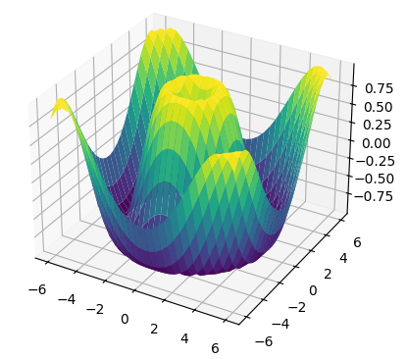
Program continues…
X, Y = np.meshgrid(x, y)
Z = f(X, Y)
ax = plt.axes(projection='3d')
ax.plot_surface(X, Y, Z, rstride=1, cstride=1,
cmap='viridis', edgecolor='none')
ax.set_title('surface');
plt.show()

Slide 14
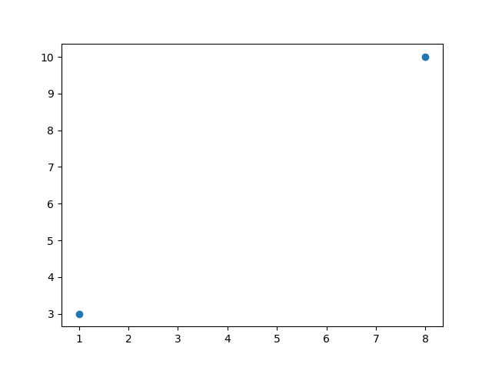
Example Draw two points in the diagram, one at position (1, 3) and one in position (8, 10):
import matplotlib.pyplot as plt import numpy as np xpoints = np.array([1, 8]) ypoints = np.array([3, 10]) plt.plot(xpoints, ypoints, 'o') plt.show()

Slide 15
Multiple Points: Draw a line in a diagram from position (1, 3) to (2, 8) then to (6, 1) and finally to position (8, 10):
import numpy as np
from matplotlib import pyplot as plt
x=np.array([1,2,6,8])
y=np.array([3,8,1,10])
plt.plot(x,y,'o')
plt.show()

Slide 16
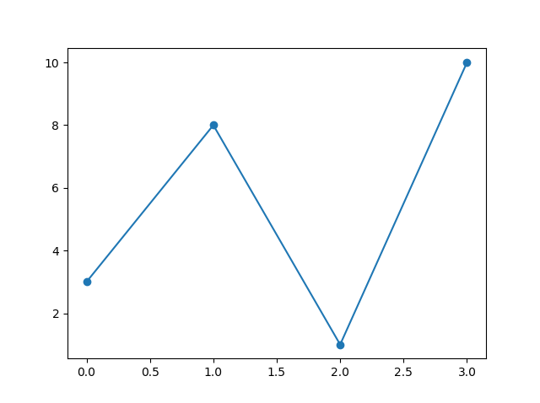
Matplotlib Markers
You can use the keyword argument marker to highlight each point with a specified marker:
import matplotlib.pyplot as plt import numpy as np ypoints = np.array([3, 8, 1, 10]) plt.plot(ypoints, marker = 'o') plt.show()

Slide 17
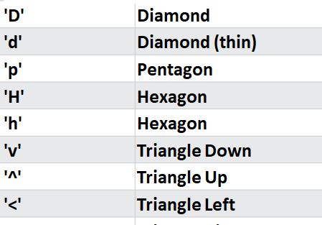
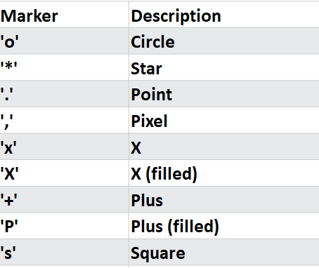
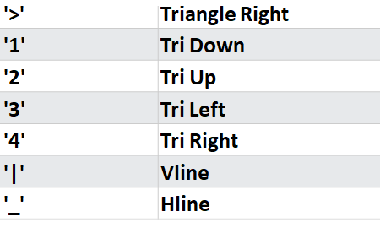
Marker Reference

Slide 18
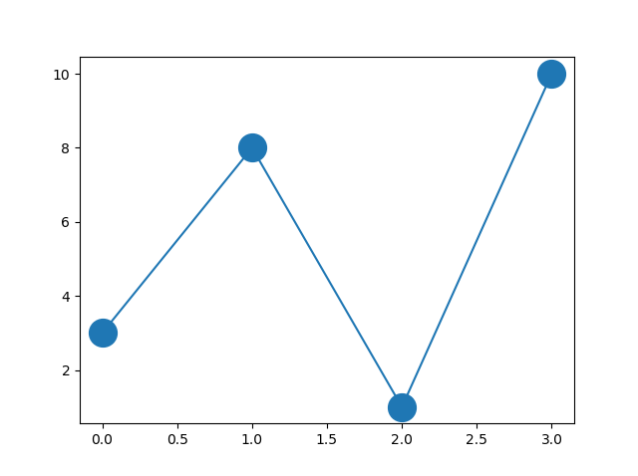
Marker Size
You can use the keyword argument marker size or the shorter version, ms to set the size of the markers:
Set the size of the markers to 20:
import matplotlib.pyplot as plt
import numpy as np
ypoints = np.array([3, 8, 1, 10])
plt.plot(ypoints, marker = 'o', ms = 20)
plt.show()

Slide 19
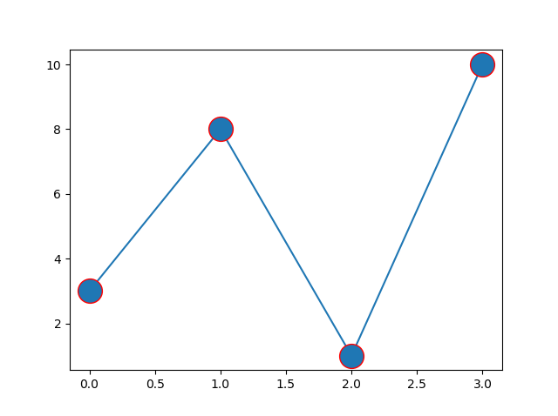
Marker Color
You can use the keyword argument marker edge color or the shorter mec to set the color of the edge of the markers:
Set the EDGE color to red:
import matplotlib.pyplot as plt
import numpy as np
ypoints = np.array([3, 8, 1, 10])
plt.plot(ypoints, marker = 'o', ms = 20, mec = 'r')
plt.show()

Slide 20
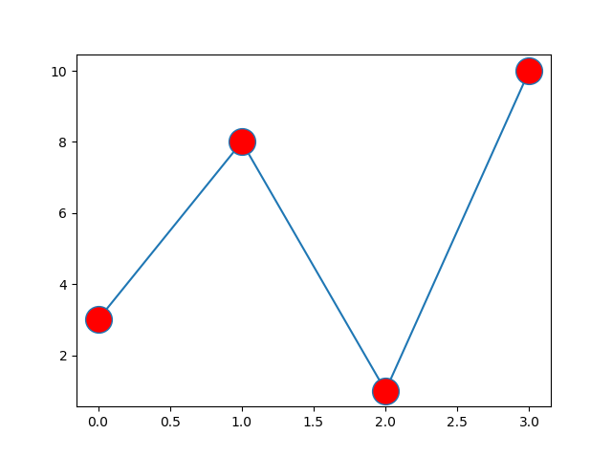
Face Color
You can use the keyword argument marker face color or the shorter mfc to set the color inside the edge of the markers:
Set the FACE color to red:
import matplotlib.pyplot as plt
import numpy as np
ypoints = np.array([3, 8, 1, 10])
plt.plot(ypoints, marker = 'o', ms = 20, mfc = 'r')
plt.show()

Slide 21
Color Reference
Color Syntax | Description
'r' | Red
'g' | Green
'b' | Blue
'c' | Cyan
'm' | Magenta
'y' | Yellow
'k' | Black
'w' | White

Slide 22
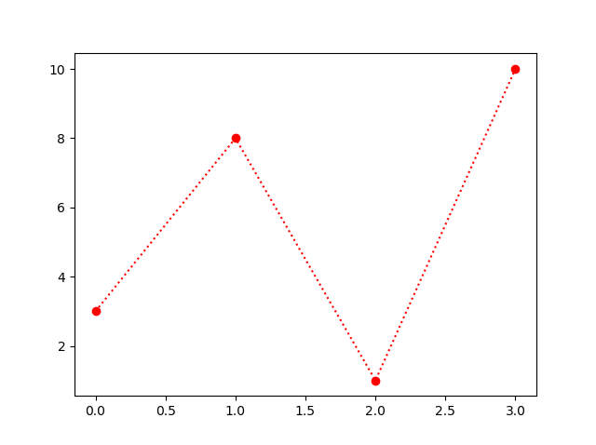
You can use also use the shortcut string notation parameter to specify the marker. marker |line | color ‘o:r’
import matplotlib.pyplot as plt import numpy as np ypoints = np.array([3, 8, 1, 10]) plt.plot(ypoints, 'o:r') plt.show()

Slide 23
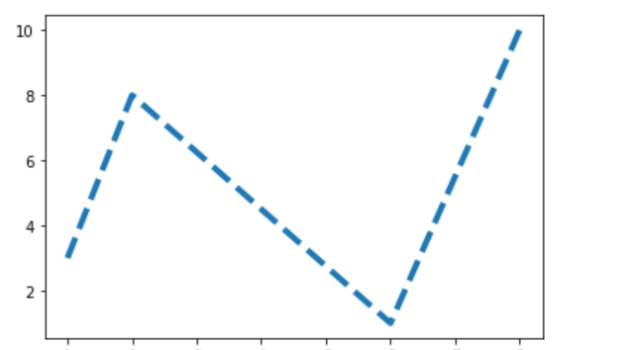
Linewidth and Line styles and line color
plt.plot(x, color = 'blue', linewidth=3, linestyle='dashed’)
Here we will use different line styles which are as follows:
– : dashed
— : double dashed
-. : dashed-dotted
: : dotted

Slide 24
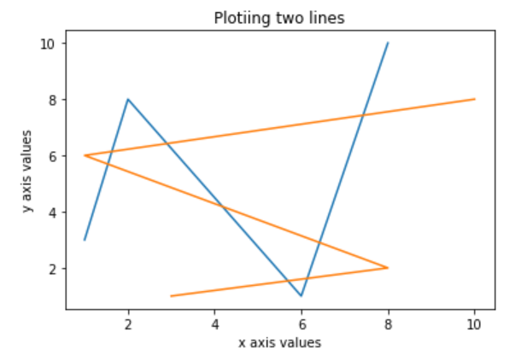
Matplotlib Title and Labels
Use title()
Use xlabel()
Use ylabel()

Slide 25
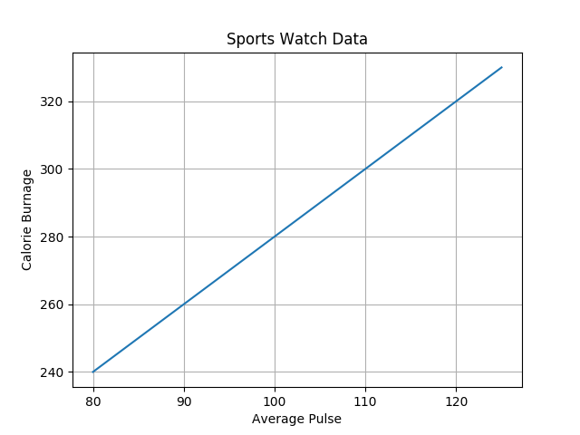
Matplotlib Adding Grid Lines
With Pyplot, you can use the grid() function to add grid lines to the plot.
import numpy as np import matplotlib.pyplot as plt x = np.array([80, 85, 90, 95, 100, 105, 110, 115, 120, 125]) y = np.array([240, 250, 260, 270, 280, 290, 300, 310, 320, 330]) plt.title("Sports Watch Data") plt.xlabel("Average Pulse") plt.ylabel("Calorie Burnage") plt.plot(x, y) plt.grid() plt.show()

Slide 26
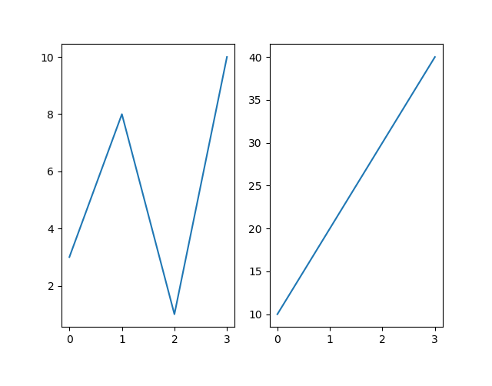
Matplotlib Subplot
With the subplot() function you can draw multiple plots in one figure.
You can use the subplot() method to add more than one plot in a figure.
Syntax:
plt.subplots(nrows, ncols, index)
The three-integer arguments specify the number of rows and columns and the index of the subplot grid.

Slide 27
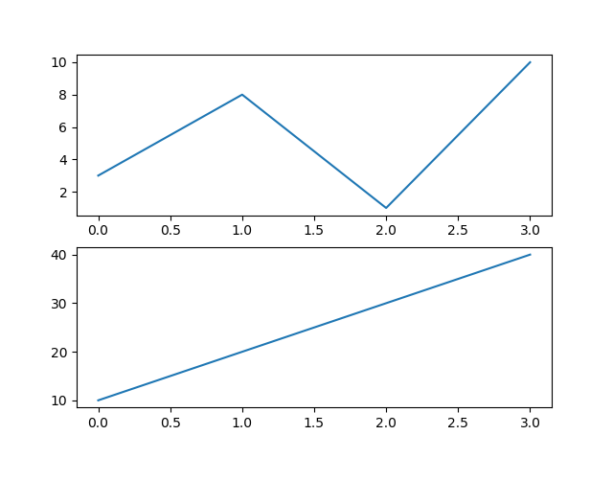
import matplotlib.pyplot as plt import numpy as np #plot 1: x = np.array([0, 1, 2, 3]) y = np.array([3, 8, 1, 10]) plt.subplot(2, 1, 1) plt.plot(x,y) #plot 2: x = np.array([0, 1, 2, 3]) y = np.array([10, 20, 30, 40]) plt.subplot(2, 1, 2) plt.plot(x,y) plt.show()

Slide 28
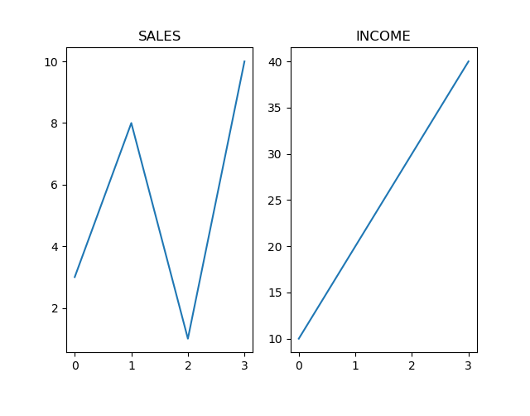
You can add a title to each plot with the title() function:
import matplotlib.pyplot as plt import numpy as np #plot 1: x = np.array([0, 1, 2, 3]) y = np.array([3, 8, 1, 10]) plt.subplot(1, 2, 1) plt.plot(x,y) plt.title("SALES") #plot 2: x = np.array([0, 1, 2, 3]) y = np.array([10, 20, 30, 40]) plt.subplot(1, 2, 2) plt.plot(x,y) plt.title("INCOME") plt.show()

Slide 29
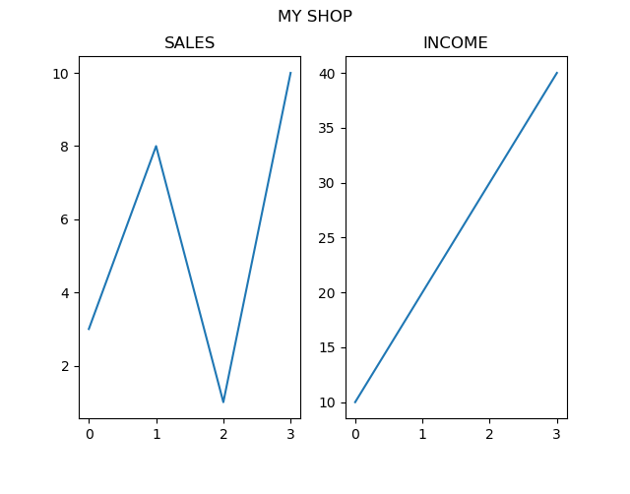
import matplotlib.pyplot as plt import numpy as np #plot 1: x = np.array([0, 1, 2, 3]) y = np.array([3, 8, 1, 10]) plt.subplot(1, 2, 1) plt.plot(x,y) plt.title("SALES") #plot 2: x = np.array([0, 1, 2, 3]) y = np.array([10, 20, 30, 40]) plt.subplot(1, 2, 2) plt.plot(x,y) plt.title("INCOME") plt.suptitle("MY SHOP") plt.show()

Slide 30
Matplotlib Scatter
Scatter plots are used to observe relationship between variables and uses dots to represent the relationship between them.
Creating Scatter Plots With pyplot, you can use the scatter() function to draw a scatter plot.
The scatter() function plots one dot for each observation. It needs two arrays of the same length, one for the values of the x-axis, and one for values on the y-axis:

Slide 31
Problem Statement:
Consider the following use case. A café sells six different types of bottled orange drinks. The owner wants to understand the relationship between the price of the drinks and how many of each one he sells, so he keeps track of how many of each drink he sells every day.
You then create lists with the price and average sales per day for each of the six orange drinks sold.
Finally, you create the scatter plot by using plt.scatter() with the two variables you wish to compare as input arguments.

Slide 32
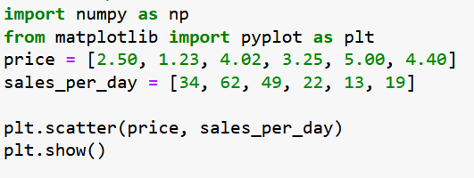
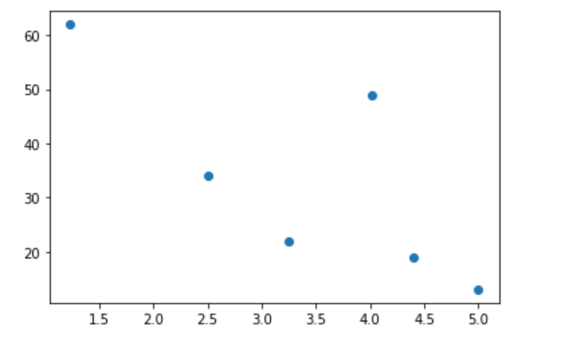

Slide 33
Customizing Markers in Scatter Plots
Changing the Size
The different orange drinks café owner sells come from different suppliers and have different profit margins. You can show this additional information in the scatter plot by adjusting the size of the marker.
The profit margin is given as a percentage:
profit_margin = np.asarray([20, 35, 40, 20, 27.5, 15])

Slide 34
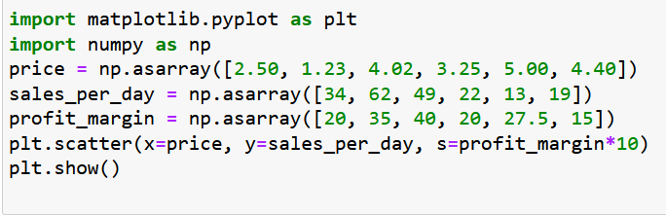
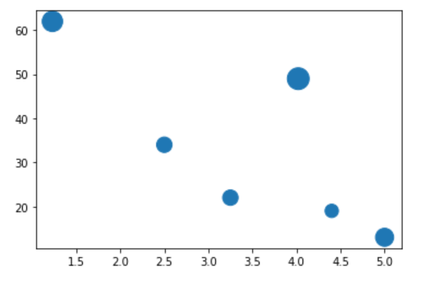
The size of the marker indicates the profit margin for each product. The two orange drinks that sell most are also the ones that have the highest profit margin.
S=size of marker

Slide 35
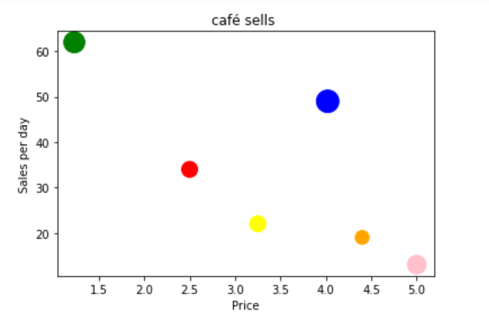
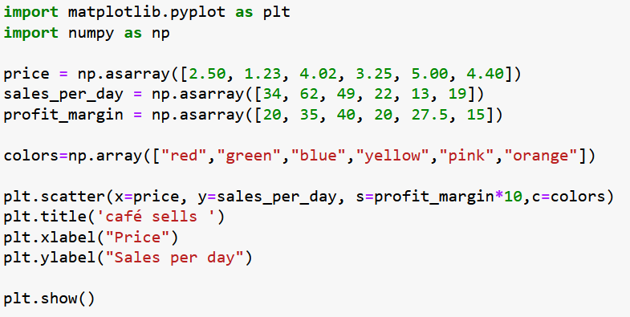
Color Each Dot

Slide 36
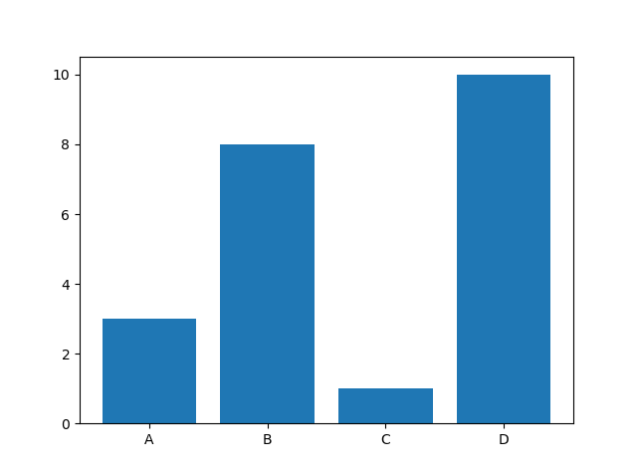
Matplotlib Bars
Creating Bars using bar()
import matplotlib.pyplot as plt import numpy as np x = np.array(["A", "B", "C", "D"]) y = np.array([3, 8, 1, 10]) plt.bar(x,y) plt.show()

Slide 37
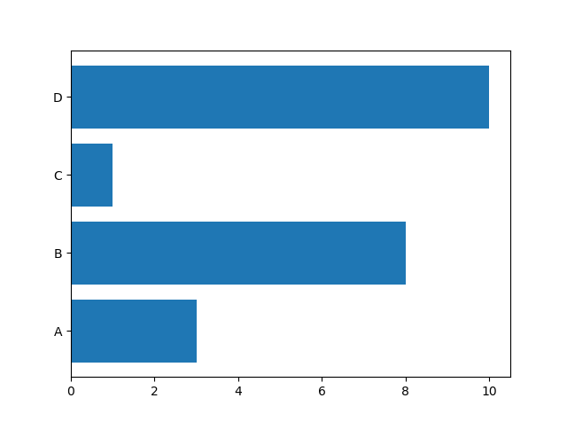
Horizontal Bars
If you want the bars to be displayed horizontally instead of vertically, use the barh() function:
Draw 4 horizontal bars:
import matplotlib.pyplot as plt import numpy as np x = np.array(["A", "B", "C", "D"]) y = np.array([3, 8, 1, 10]) plt.barh(x, y) plt.show()

Slide 38
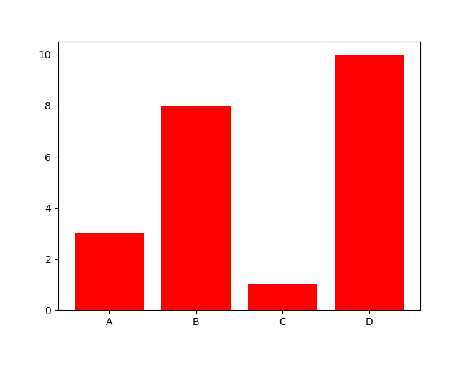
Bar Color
The bar() and barh() takes the keyword argument color to set the color of the bars:
Example
Draw 4 red bars:
import matplotlib.pyplot as plt import numpy as np x = np.array(["A", "B", "C", "D"]) y = np.array([3, 8, 1, 10]) plt.bar(x, y, color = "red") plt.show()

Slide 39
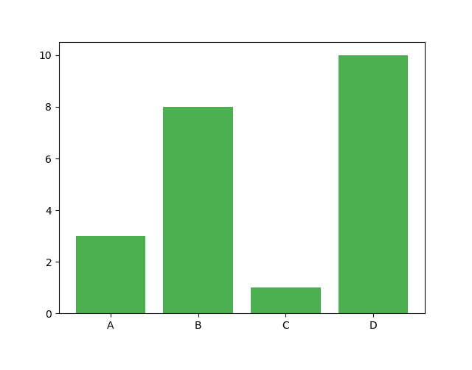
Color Hex
Example
Draw 4 bars with a beautiful green color:
import matplotlib.pyplot as plt import numpy as np x = np.array(["A", "B", "C", "D"]) y = np.array([3, 8, 1, 10]) plt.bar(x, y, color = "#4CAF50") plt.show()

Slide 40
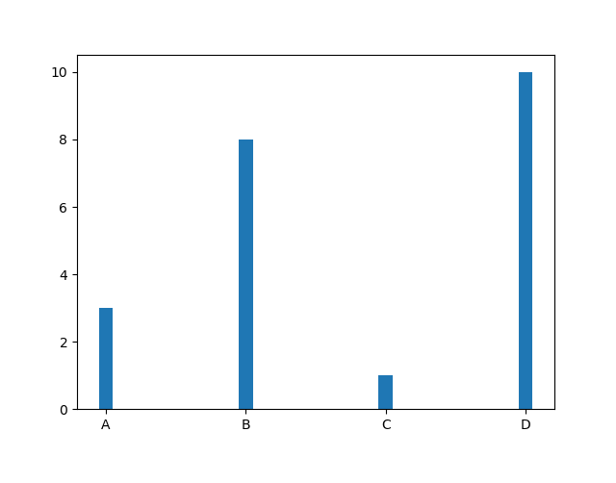
Bar Width
The bar() takes the keyword argument width to set the width of the bars:
import matplotlib.pyplot as plt import numpy as np x = np.array(["A", "B", "C", "D"]) y = np.array([3, 8, 1, 10]) plt.bar(x, y, width = 0.1) plt.show()

Slide 41
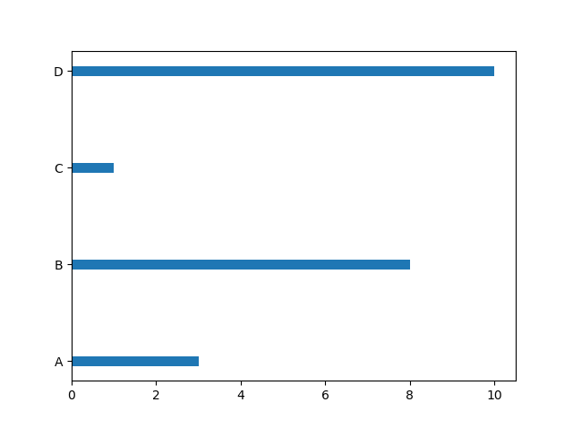
Bar Height
The barh() takes the keyword argument height to set the height of the bars:
import matplotlib.pyplot as plt import numpy as np x = np.array(["A", "B", "C", "D"]) y = np.array([3, 8, 1, 10]) plt.barh(x, y, height = 0.1) plt.show()

Slide 42
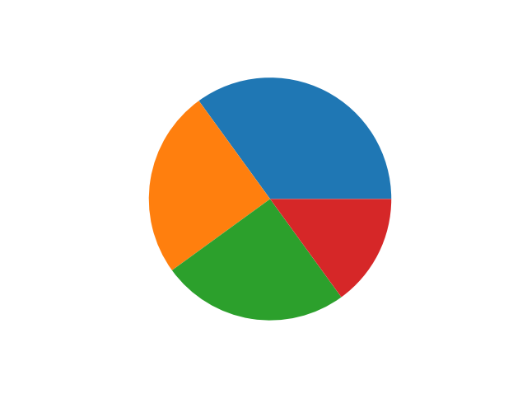
Matplotlib Pie Charts
Creating Pie Charts use the pie() function
pie chart draws one piece (called a wedge) for each value in the list
By default the plotting of the first wedge starts from the x-axis and move anti clockwise
import matplotlib.pyplot as plt import numpy as np y = np.array([35, 25, 25, 15]) plt.pie(y) plt.show()

Slide 43
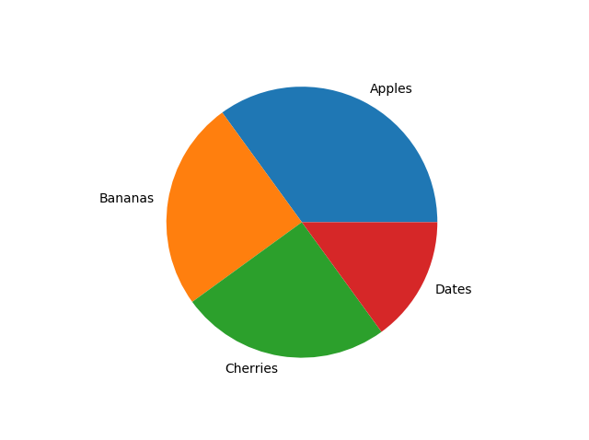
Labels
Add labels to the pie chart with the label parameter.
The label parameter must be an array with one label for each wedge:
import matplotlib.pyplot as plt import numpy as np y = np.array([35, 25, 25, 15]) mylabels = ["Apples", "Bananas", "Cherries", "Dates"] plt.pie(y, labels = mylabels) plt.show()

Slide 44
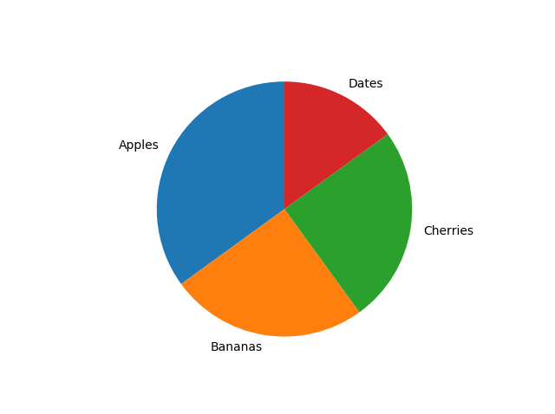
startangle
Start the first wedge at 90 degrees:
import matplotlib.pyplot as plt import numpy as np y = np.array([35, 25, 25, 15]) mylabels = ["Apples", "Bananas", "Cherries", "Dates"] plt.pie(y, labels = mylabels, startangle = 90) plt.show()

Slide 45
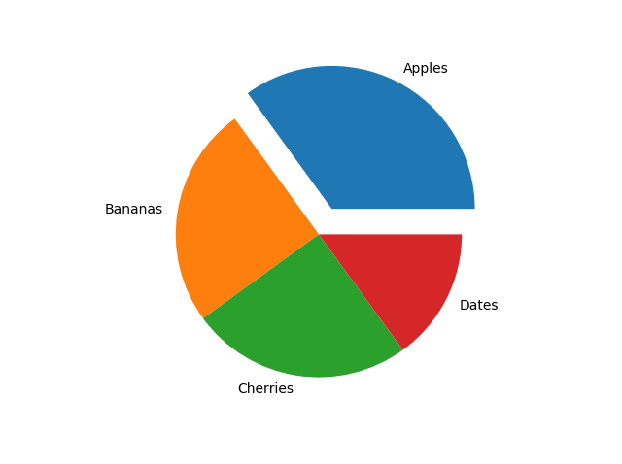
Explode
you want one of the wedges to stand out? The explode parameter allows you to do that.
Example
Pull the "Apples" wedge 0.2 from the center of the pie:
import matplotlib.pyplot as plt import numpy as np y = np.array([35, 25, 25, 15]) mylabels = ["Apples", "Bananas", "Cherries", "Dates"] myexplode = [0.2, 0, 0, 0] plt.pie(y, labels = mylabels, explode = myexplode) plt.show()

Slide 46
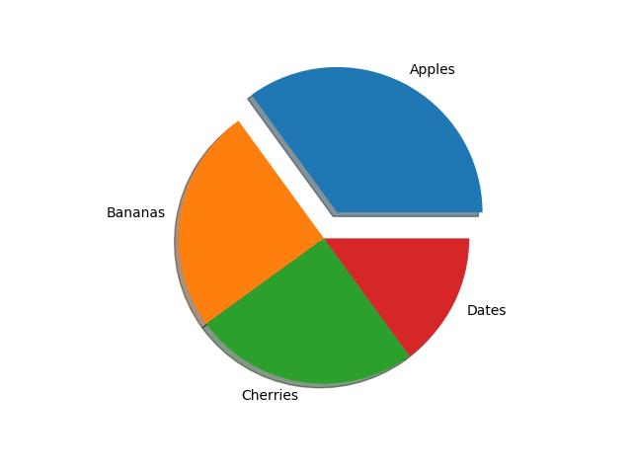
Shadow
Add a shadow to the pie chart by setting the shadows parameter to True:
import matplotlib.pyplot as plt import numpy as np y = np.array([35, 25, 25, 15]) mylabels = ["Apples", "Bananas", "Cherries", "Dates"] myexplode = [0.2, 0, 0, 0] plt.pie(y, labels = mylabels, explode = myexplode, shadow = True) plt.show()

Slide 47
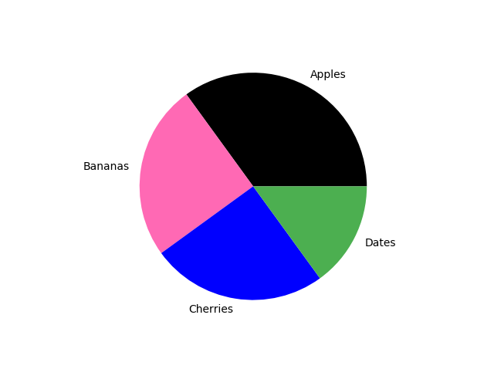
Colors
import matplotlib.pyplot as plt import numpy as np y = np.array([35, 25, 25, 15]) mylabels = ["Apples", "Bananas", "Cherries", "Dates"] mycolors = ["black", "hotpink", "b", "#4CAF50"] plt.pie(y, labels = mylabels, colors = mycolors) plt.show()

Slide 48
legend()
import matplotlib.pyplot as plt
data=[10,12,25,27,30,18]
cars=['Marcedeez','BMW','Honda City','Swift','Thar','Nano']
myexplode=[0,0,0.1,0,0,0]
mycolors=['r','g','y','b','m','c']
plt.pie(data,labels=cars,colors=mycolors)
plt.legend(title="Car Models")
plt.show()

Slide 49
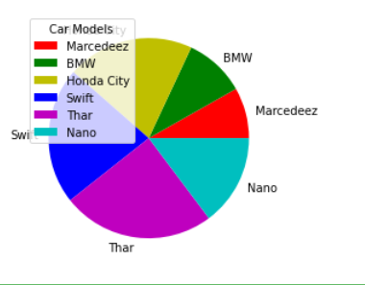

Slide 50
Matplotlib Histograms
A histogram is a graph showing frequency distributions.
It is a graph showing the number of observations within each given interval.
We have to find frequency according to given range.
In Matplotlib, we use the hist() function to create histograms.

Slide 51
For example there are group of peoples in a park. We can find the people according to age group.
range | frequency
0-10 | ?
10-20 | ?
20-30 | ?
30-40 | ?
40-50 | ?
50-60 | ?
60-70 | ?
70-80 | ?
80-90 | ?
90-100 | ?

Slide 52
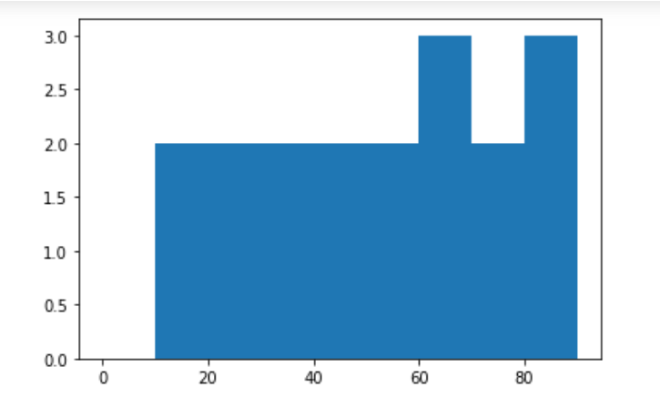
Code:
from matplotlib import pyplot as plt
import numpy as np
peoples=np.array([10,34,55,20,18,66,74,65,80,88,76,45,35,42,85,62,23,50])
age_group=np.array([0,10,20,30,40,50,60,70,80,90])
plt.hist(peoples,age_group)
plt.show()

Slide 53
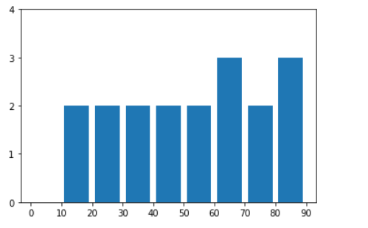
rwidth,xticks,yticks
import matplotlib.pyplot as plt
peoples=[10,34,55,20,18,66,74,65,80,88,76,45,35,42,85,62,23,50]
age_group=[0,10,20,30,40,50,60,70,80,90]
plt.hist(peoples,age_group,rwidth=0.8)
plt.xticks(age_group)
plt.yticks(range(0,5))
plt.show()

Slide 54
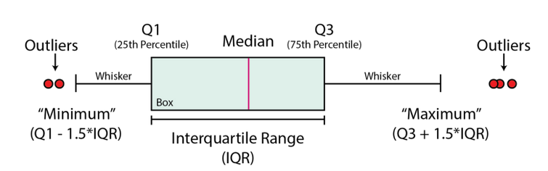
Box and whisker plot
A box and whisker plot is a graphical and standardized way to display the distribution of data based on five key numbers:
The “minimum”, 1st Quartile (25th percentile),
median (2nd Quartile./ 50th Percentile),
the 3rd Quartile (75th percentile), and the “maximum”.
The minimum and maximum values are defined as
Q1–1.5 * IQR and Q3 + 1.5 * IQR respectively.
Any points that fall outside of these limits are referred to as outliers.

Slide 55
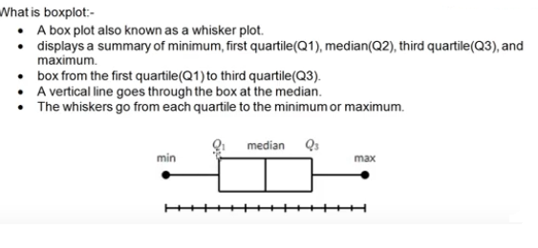

Slide 56
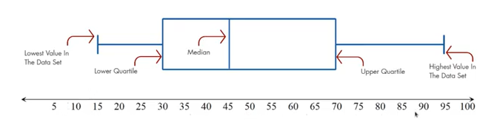
Q1
Q4
Q2
Q3
Median=45
Range=max-min(95-15)
IQR=70-30

Slide 57
Suppose we have distribution:
[10,20,70,50,30,60,40,80]
Do the sorting at first:
[10,20,30,40,50,60,70,80]

Slide 58
Boxplots can be used to:
Identify outliers or irregular data points
To determine if our data is skewed
To understand the spread/range of the data

Slide 59
import pandas as pd
import matplotlib.pyplot as plt
dataframe = pd.read_csv("winequality-red.csv")
fixed_acidity = dataframe["fixed acidity"]
free_sulfur_dioxide = dataframe['free sulfur dioxide']
total_sulfur_dioxide = dataframe['total sulfur dioxide']
alcohol = dataframe['alcohol']
fig, ax = plt.subplots()
ax.boxplot(fixed_acidity)
plt.show()

Slide 60
introduction to seaborn
Seaborn is the extended version of Matplotlib which uses Matplotlib along with Numpy and Pandas for plotting graphs.
It helps in visualizing univariate and bivariate data. It uses beautiful themes for decorating Matplotlib graphics.

Slide 61
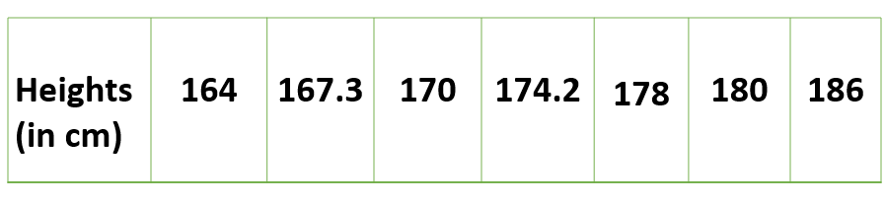
1. Univariate data – This type of data consists of only one variable.

Slide 62
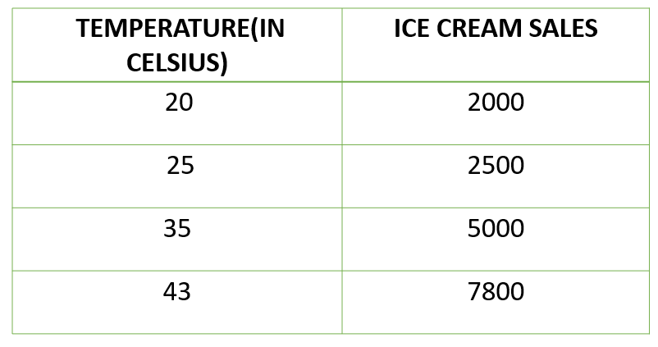
2. Bivariate data – This type of data involves two different variables.

Slide 63
seaborn Vs matplotlib

Slide 64
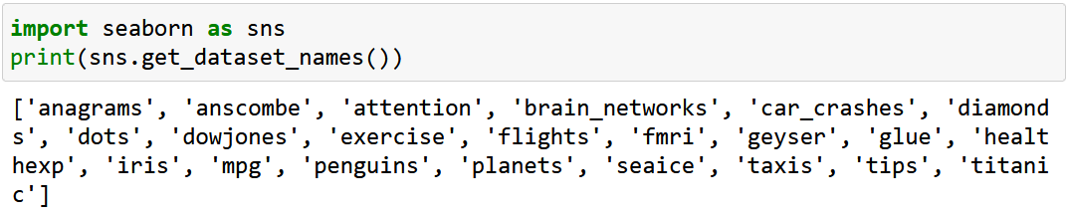
data visualization using seaborn
Importing Datasets
Seaborn comes with a few important datasets in the library. When Seaborn is installed, the datasets download automatically.

Slide 65

import dataset using load_dataset()

Slide 66

Using pandas to read csv file and plot graph using seaborn

Slide 67

Create Multiple line plots with HUE:
We can add multiple line plots by using the hue parameter. You can create multiple lines by grouping variables using the hue parameter.
Suppose in fmri dataset event column having two types: stim and cue. Then we can plot multiline by using hue parameter

Slide 68


Slide 69

style and markers parameters
Style: to highlight line graph using solid line
Markers: to highlight line graph using points

Slide 70

Plot bar graph using barplot()

Slide 71

Use of palette in barplot()

Slide 72

The possible value of the palette are:

Slide 73

scatterplot()

Slide 74

Heatmap
Heatmap is a graphical representation of 2D (two dimensional) data. Each data value represents in a matrix and it has a special color.

Slide 75

Assignment1
Write a Python programming to create a pie chart of gold medal achievements of five most successful countries in 2016 Summer Olympics. Read the data from a csv file. Sample data: country,gold_medal United States,46 Great Britain,27 China,26 Russia,19 Germany,17

Slide 76

Assignment-2
Write a Python programming to display a bar chart of the popularity of programming Languages. Increase bottom margin. Sample data: Programming languages: Java, Python, PHP, JavaScript, C#, C++ Popularity: 22.2, 17.6, 8.8, 8, 7.7, 6.7

Slide 77

Assignment3
Write a Python program to draw line charts of the financial data of Alphabet Inc. between October 3, 2016 to October 7, 2016. Sample Financial data (fdata.csv): Date,Open,High,Low,Close 10-03-16,774.25,776.065002,769.5,772.559998 10-04-16,776.030029,778.710022,772.890015,776.429993 10-05-16,779.309998,782.070007,775.650024,776.469971 10-06-16,779,780.47998,775.539978,776.859985 10-07-16,779.659973,779.659973,770.75,775.080017

Slide 78
Casestudy 6 to 10

